Slide 1
Tracking a Lacrosse Ball within Game Footage
Austin Huang

Slide 2
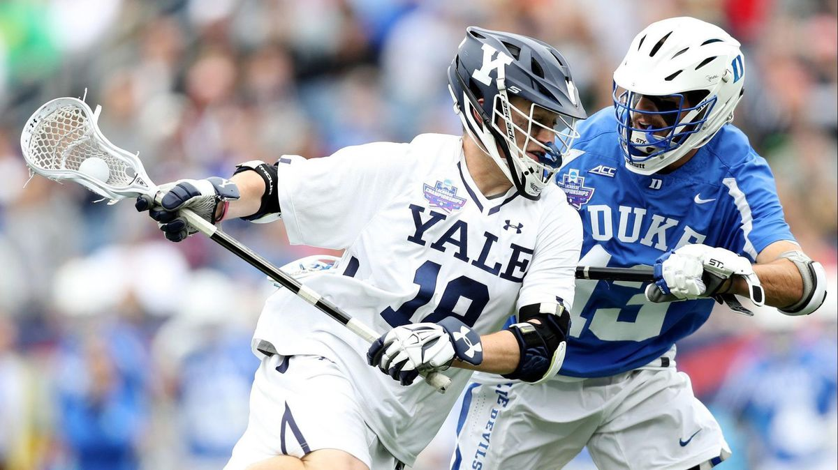
Lacrosse
National
Northeast and mid-Atlantic
NCAA, MLL, PLL
https://www.google.com/url?sa=i&source=images&cd=&ved
Notes:
PLL has six teams, each with 26 players
TV broadcasters expressed disinterest in lacrosse because it was not entertaining enough to watch

Slide 3
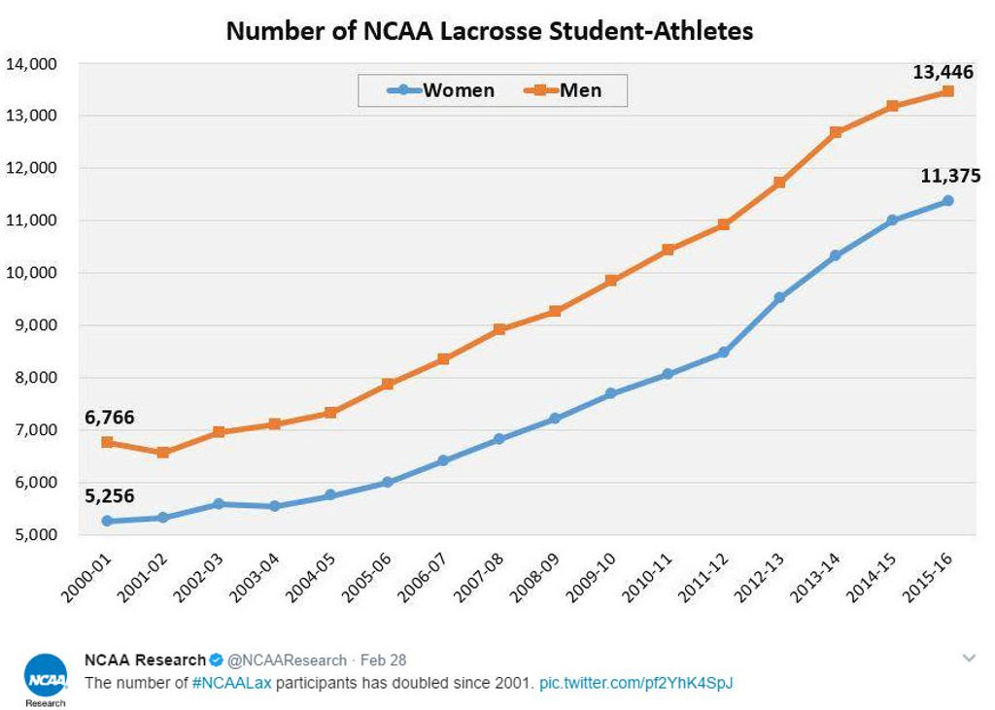
Popularity
Growing collegiately
https://www.nvlax.org/page/show/

Slide 4
Growth of lacrosse will need a growth of audience and analysts.

Slide 5

Game footage
Ball is white, size of tennis ball
Hard to see in broadcast
2.5 inches

Slide 6
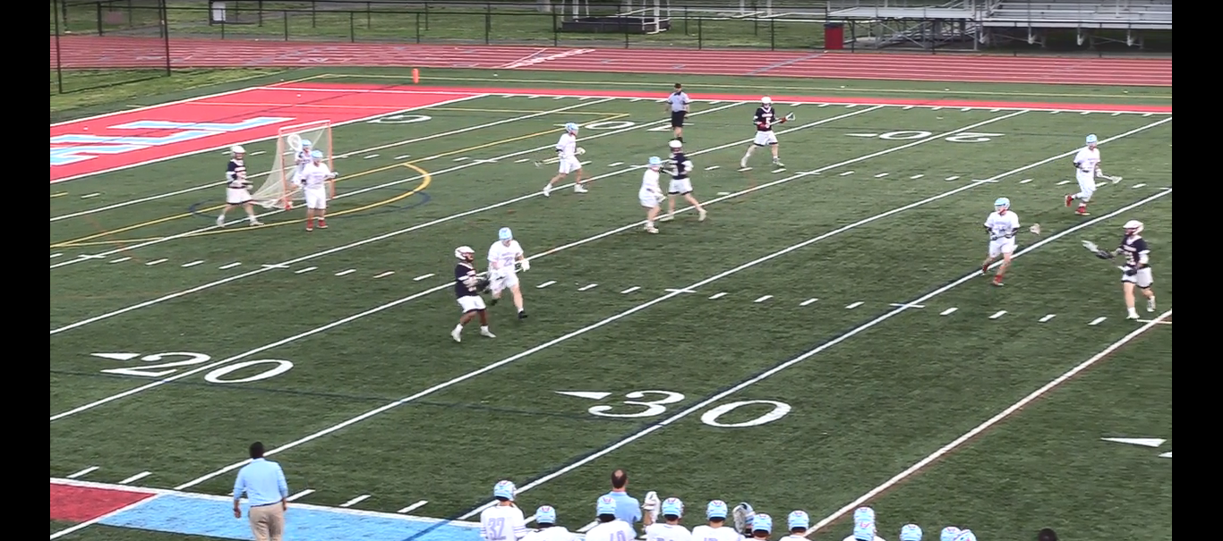

Slide 7
Proposal
Create program to highlight ball or player in possession
Color tracking
Trajectory tracking
Assist newcomers and analysts

Slide 8
Works Cited
http://www.sportspromedia.com/analysis/premier-lacrosse-league-mike-rabil-paul-rabil-boston-interview-feature

